Slide 1
- Timeline for Promoting AVS 72
As Easy as “ABC…”
Amass
Brand
Contact
Do Again
Now-February 9
February 9-May 18
February 9-28
March-Sept 14
Add 10+ colleagues to your topics Google Contact Sheet.
Della will e-mail the link
Use the provided resources and tools at avs72.avs.org/promotion/ to customize and create banners that have your topics specific branding.
Della will e-mail the link
Use your topic specific branded banners to e-mail your assigned Google contacts.
Post regularly to social media pages and tag #AVS72
(especially Linked in)
Keep creating new branded content for
e-mails and social
media posts and promote late news
Della will e-mail ideas and prompts or use the resources at avs72.avs.org/promotion/

Slide 2
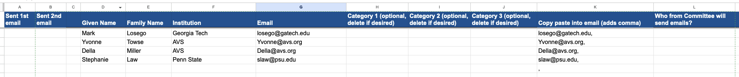
- Google Sheets Have Been Pre-Made for all Topics -
Links Have Been Shared – Start Adding
Track when first email and reminder email are sent here!
Optional categorization, just delete columns if your D/F/G won’t use them.
Committee member adds their name here (who is responsible to contact.)
Column is autogenerated with a comma for easy email list generation.
Committee can just add all this information for each of their contacts

Slide 3
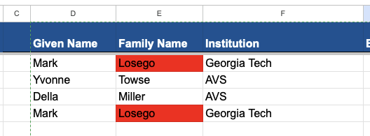
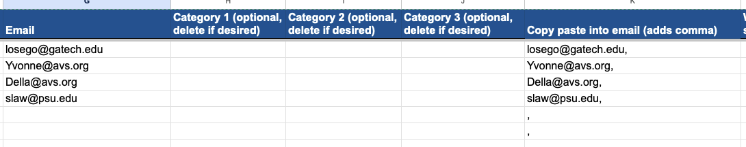
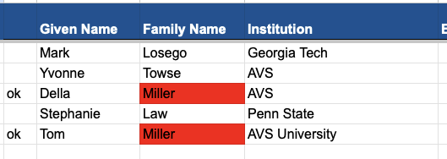
- Google Sheets Have Been Pre-Made for all Topics -
Sheets are also coded to create a column with emails that end with a comma. This makes it easy to copy-paste directly into your email if you want to send a group message.
Sheets are already coded to highlight in red repeated last names to help quickly identify duplicate entries.
Type in this column
Auto adds comma here
PRO TIP: Send as a BCC message to multiple contacts all at once!
Will still highlight people with same last names, so can just use column to left to “ok”

Slide 4
- Customizing Your Own AVS 72 Promotional Banners -
How to Update the Custom Banner Templates:
Slide 5 provides the branded color palate for AVS 72.
Note: We ask that you don’t deviate from these colors.
Slides 9-11 have custom banner templates for you to modify.
How to Export Your Custom Banner(s):
Note what slide number(s) you would like to export.
Click on File in the main menu tab at the top.
Click Save As in the drop-down list and then select jpg or png as the Save Option. Once you hit Save there will be a popup that asks what slide you would like to export.
Where to Use Your Custom Banner(s) to Promote:
Use your custom banner(s) to promote on social media,
e-mail, or in other presentations. See Slides 6-7 for Social Media instructions and Slide 8 for Print, E-mail, and Other Media suggestions.
Items to Highlight in Your Banner(s):
Customize the banner to promote the action you would like them to take. If it is Call for Abstracts season link to Submit Abstracts and include the deadline. If it is Technical Program season let them know to View Program or Register.
Regardless of the season highlight what is important for your topic.
  Promote featured invited speakers with their photos.
  Provide invited speakers with a banner that says, “Don’t Miss My Invited Talk”.
  Ask each Program Committee Member to promote “I Have Submitted My Abstract”.
  Highlight specific talk or students or awards.
Refer to the AVS 72 Promotional Tips and Tools page for more ideas as well as additional graphics and updates. There is also an e-mail template to customize.

Slide 5
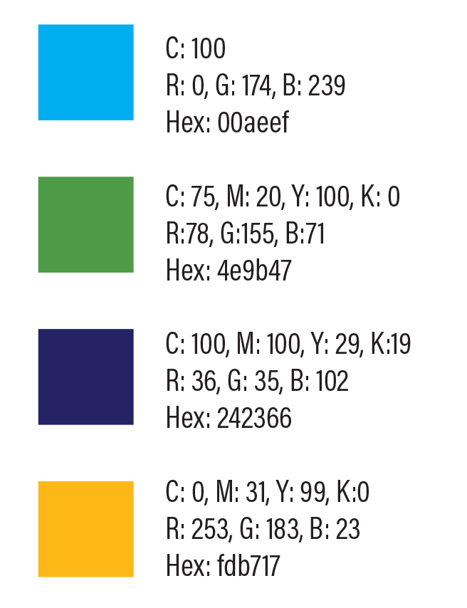


AVS 72 Colors
AVS 72 Colors
AVS 72 Colors
AVS 72 Colors

Slide 6

- Promote AVS 72 on Social Media Platforms -
Step 1:
Follow AVS
Follow AVS on your favorite social media sites. Scan the QR codes on slide 7 to follow us.
Example Post:
Step 2:
Like and Reshare
  Like and reshare AVS on your favorite social media sites. It is important to reshare and put your own comments.
Post Image:
Insert your Custom Banner or the 1200 x 675 provided banners into your social media post(s).
Step 3:
Create & Share a Custom Social Media Post
  Create a custom banner following the instructions on slide 4. You can also use the provided 1200 x 675 banner (slides 12-14) for these posts.
  Create your post. Refer to slide 4 or https://avs72.avs.org/promotion/ for ideas. Be sure to use #AVS72 and tag AVS on the appropriate AVS Social Media site(s) on Slide 7 (especially Linked in).
Post Content:
Submit your #AVS72 #2DMaterials Abstracts by Sept. 14. Della Miller, AVS will be one of the many invited speakers presenting work in the 2D Materials sessions this Nov. 8-13, 2026, in Pittsburgh, PA [Tag AVS Social Site Here]
https://avs72.avs.org/group-2d/
  Link the post to www.avs72.avs.org or your specific topic page.

Slide 7




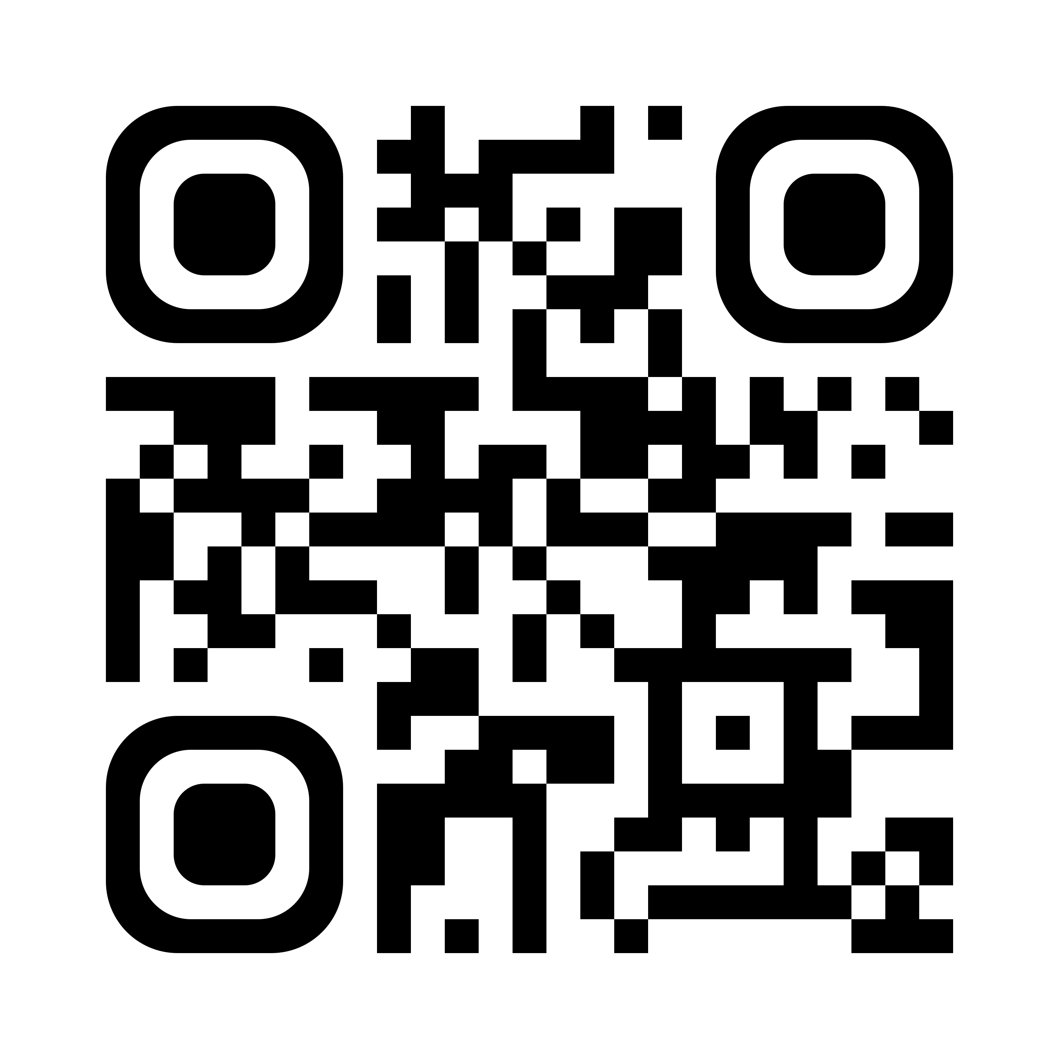
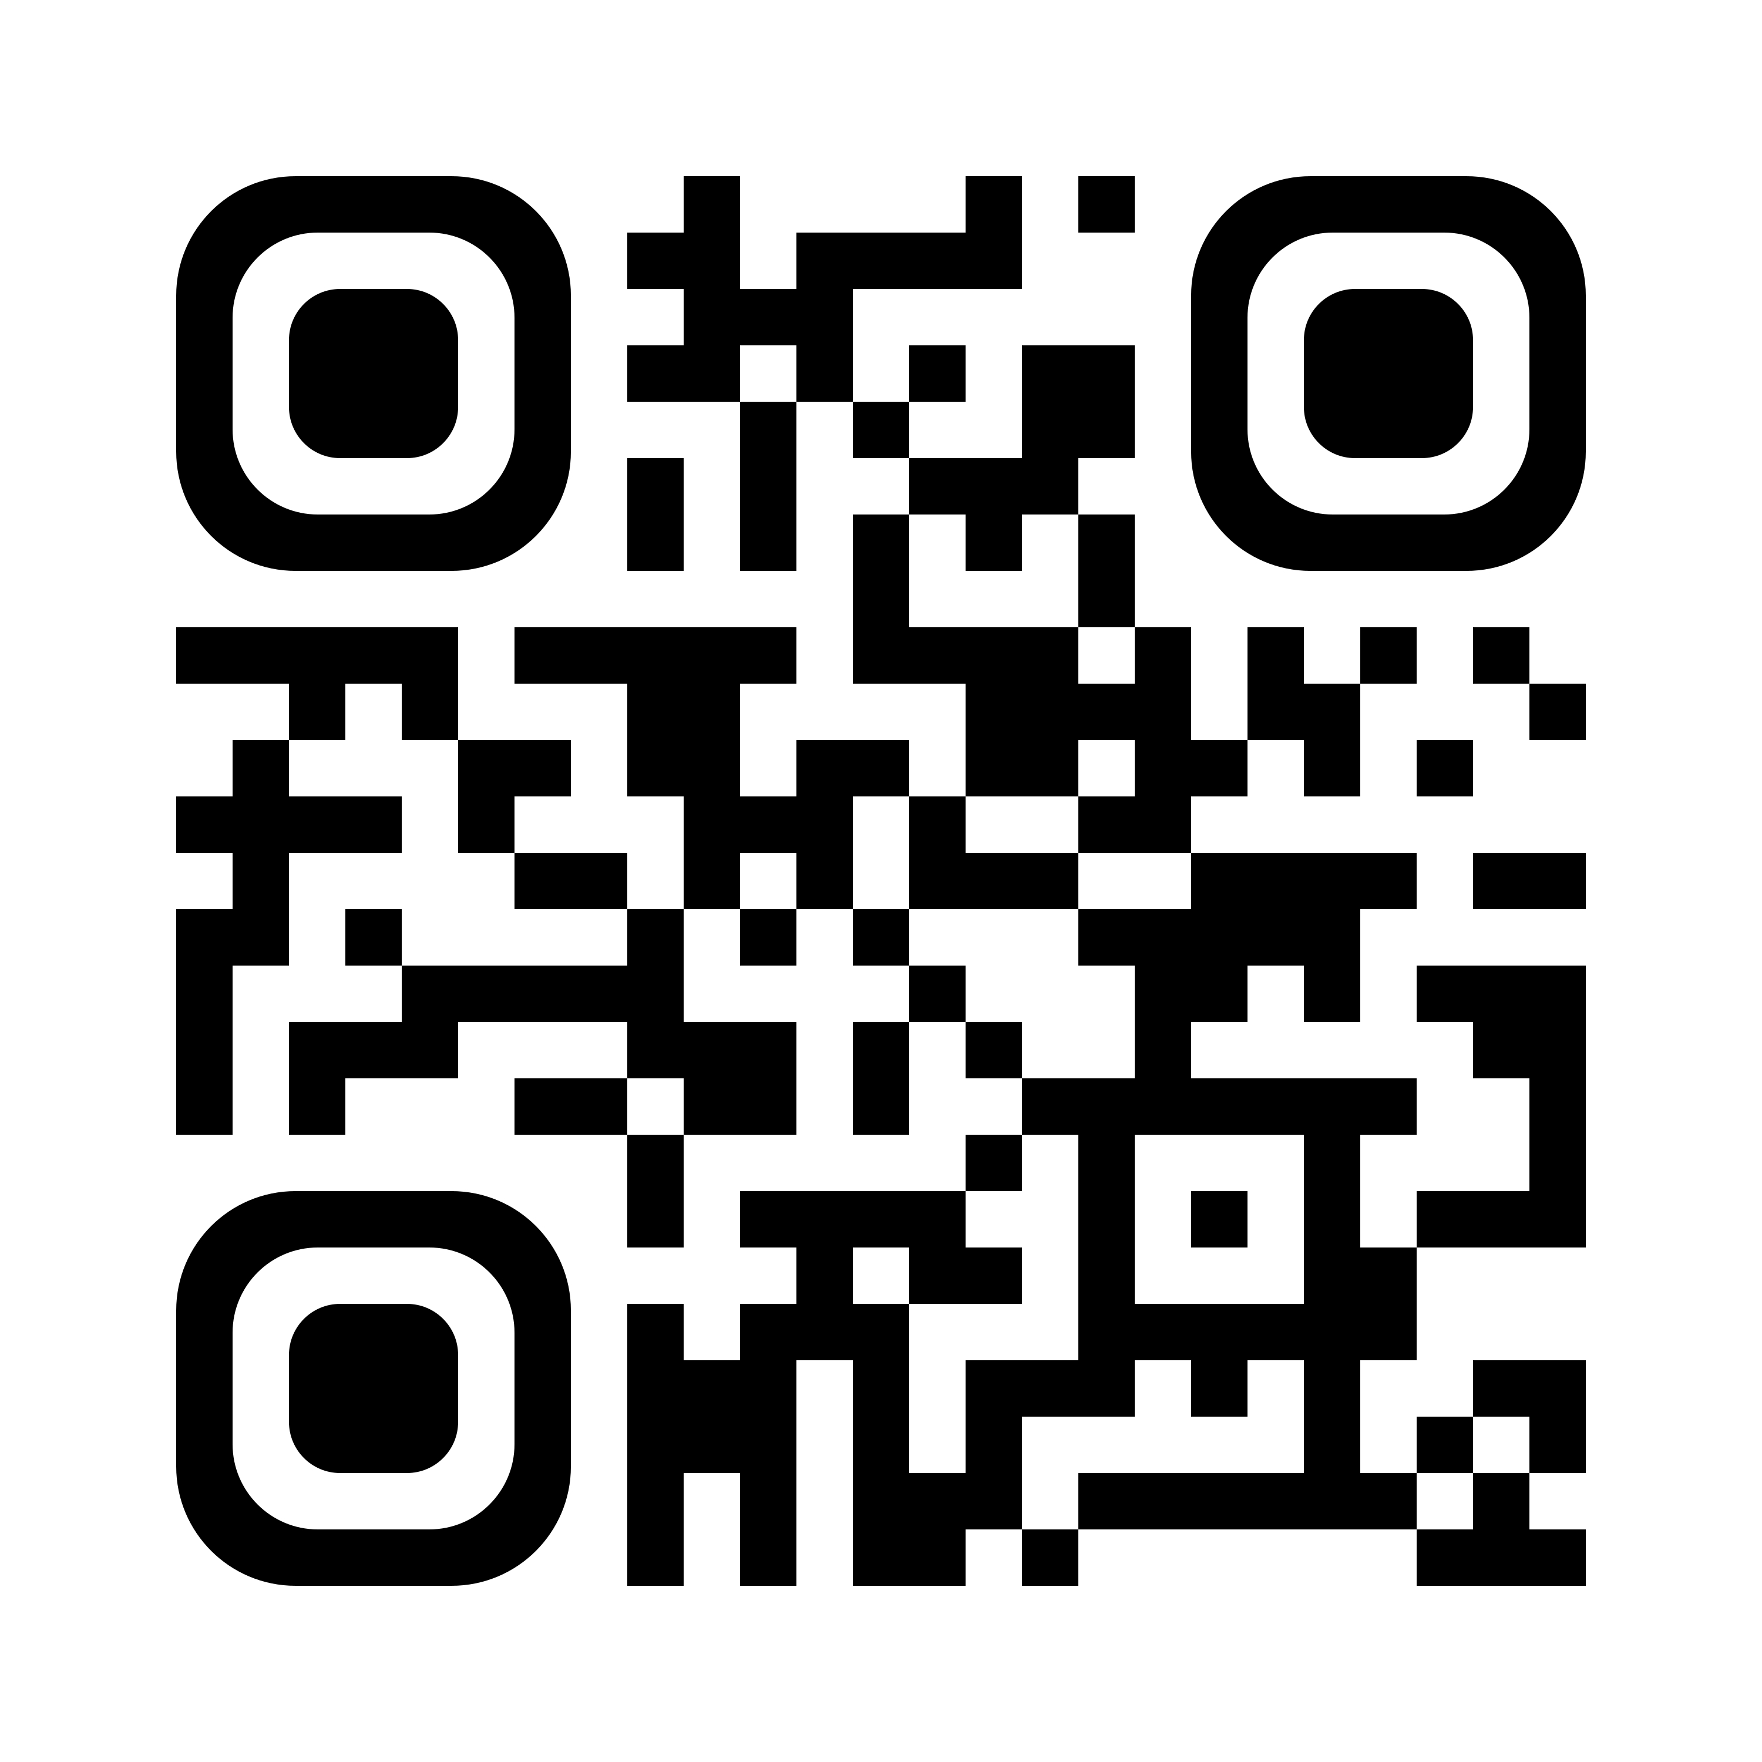
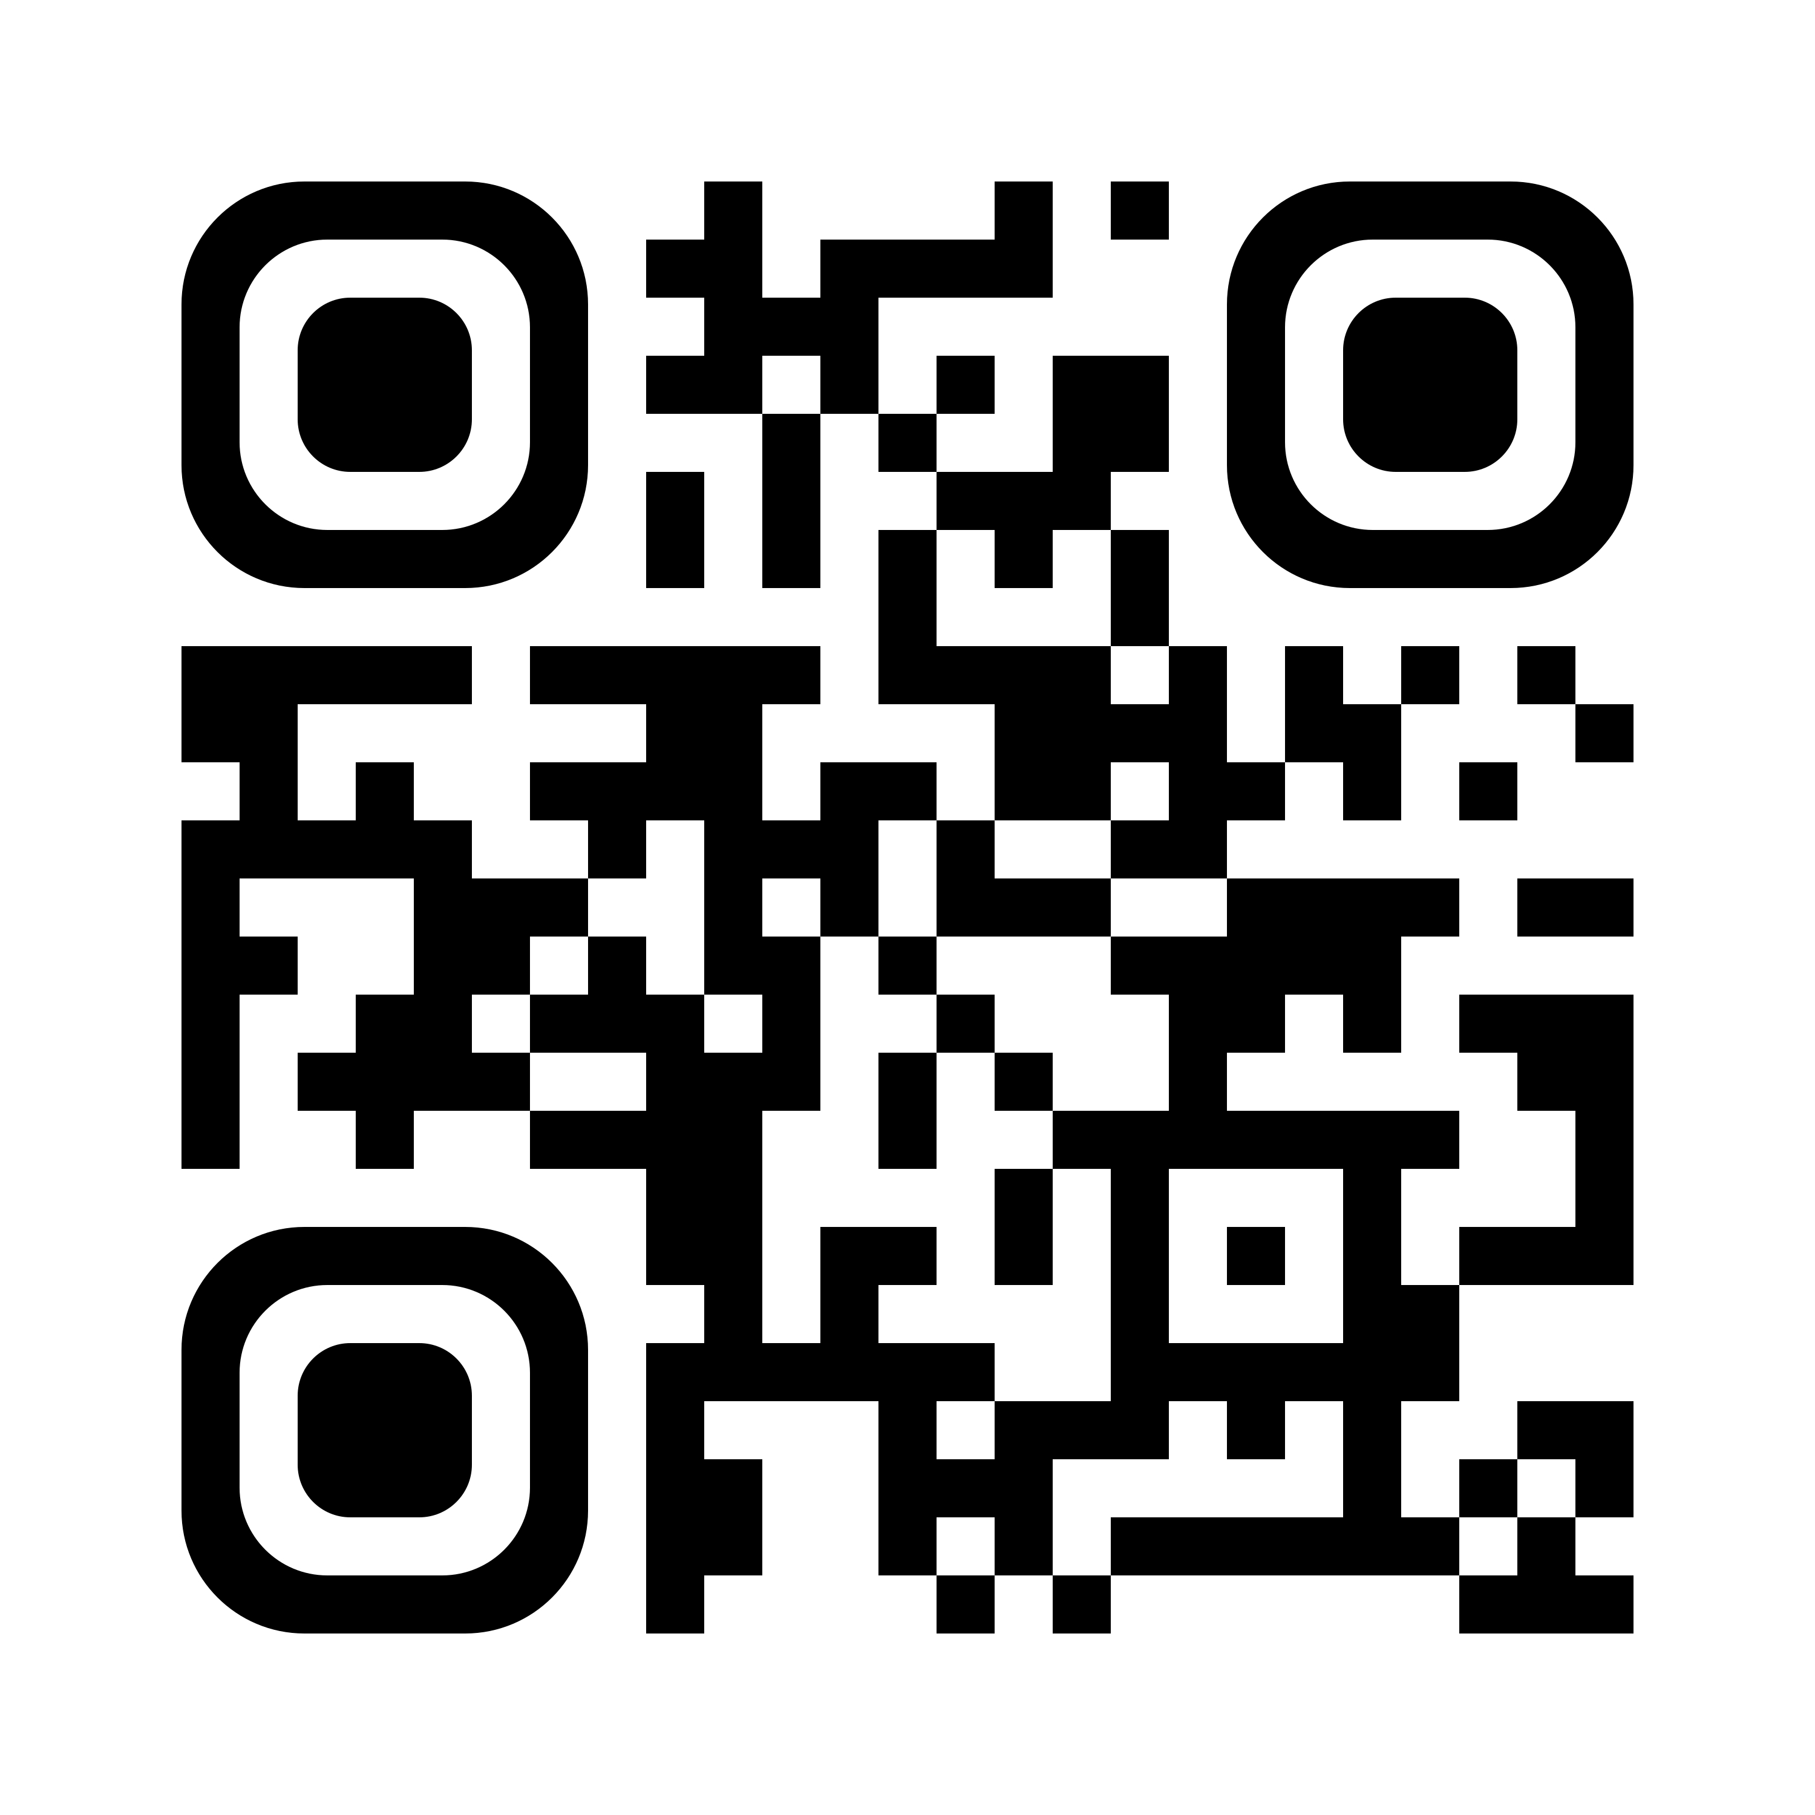
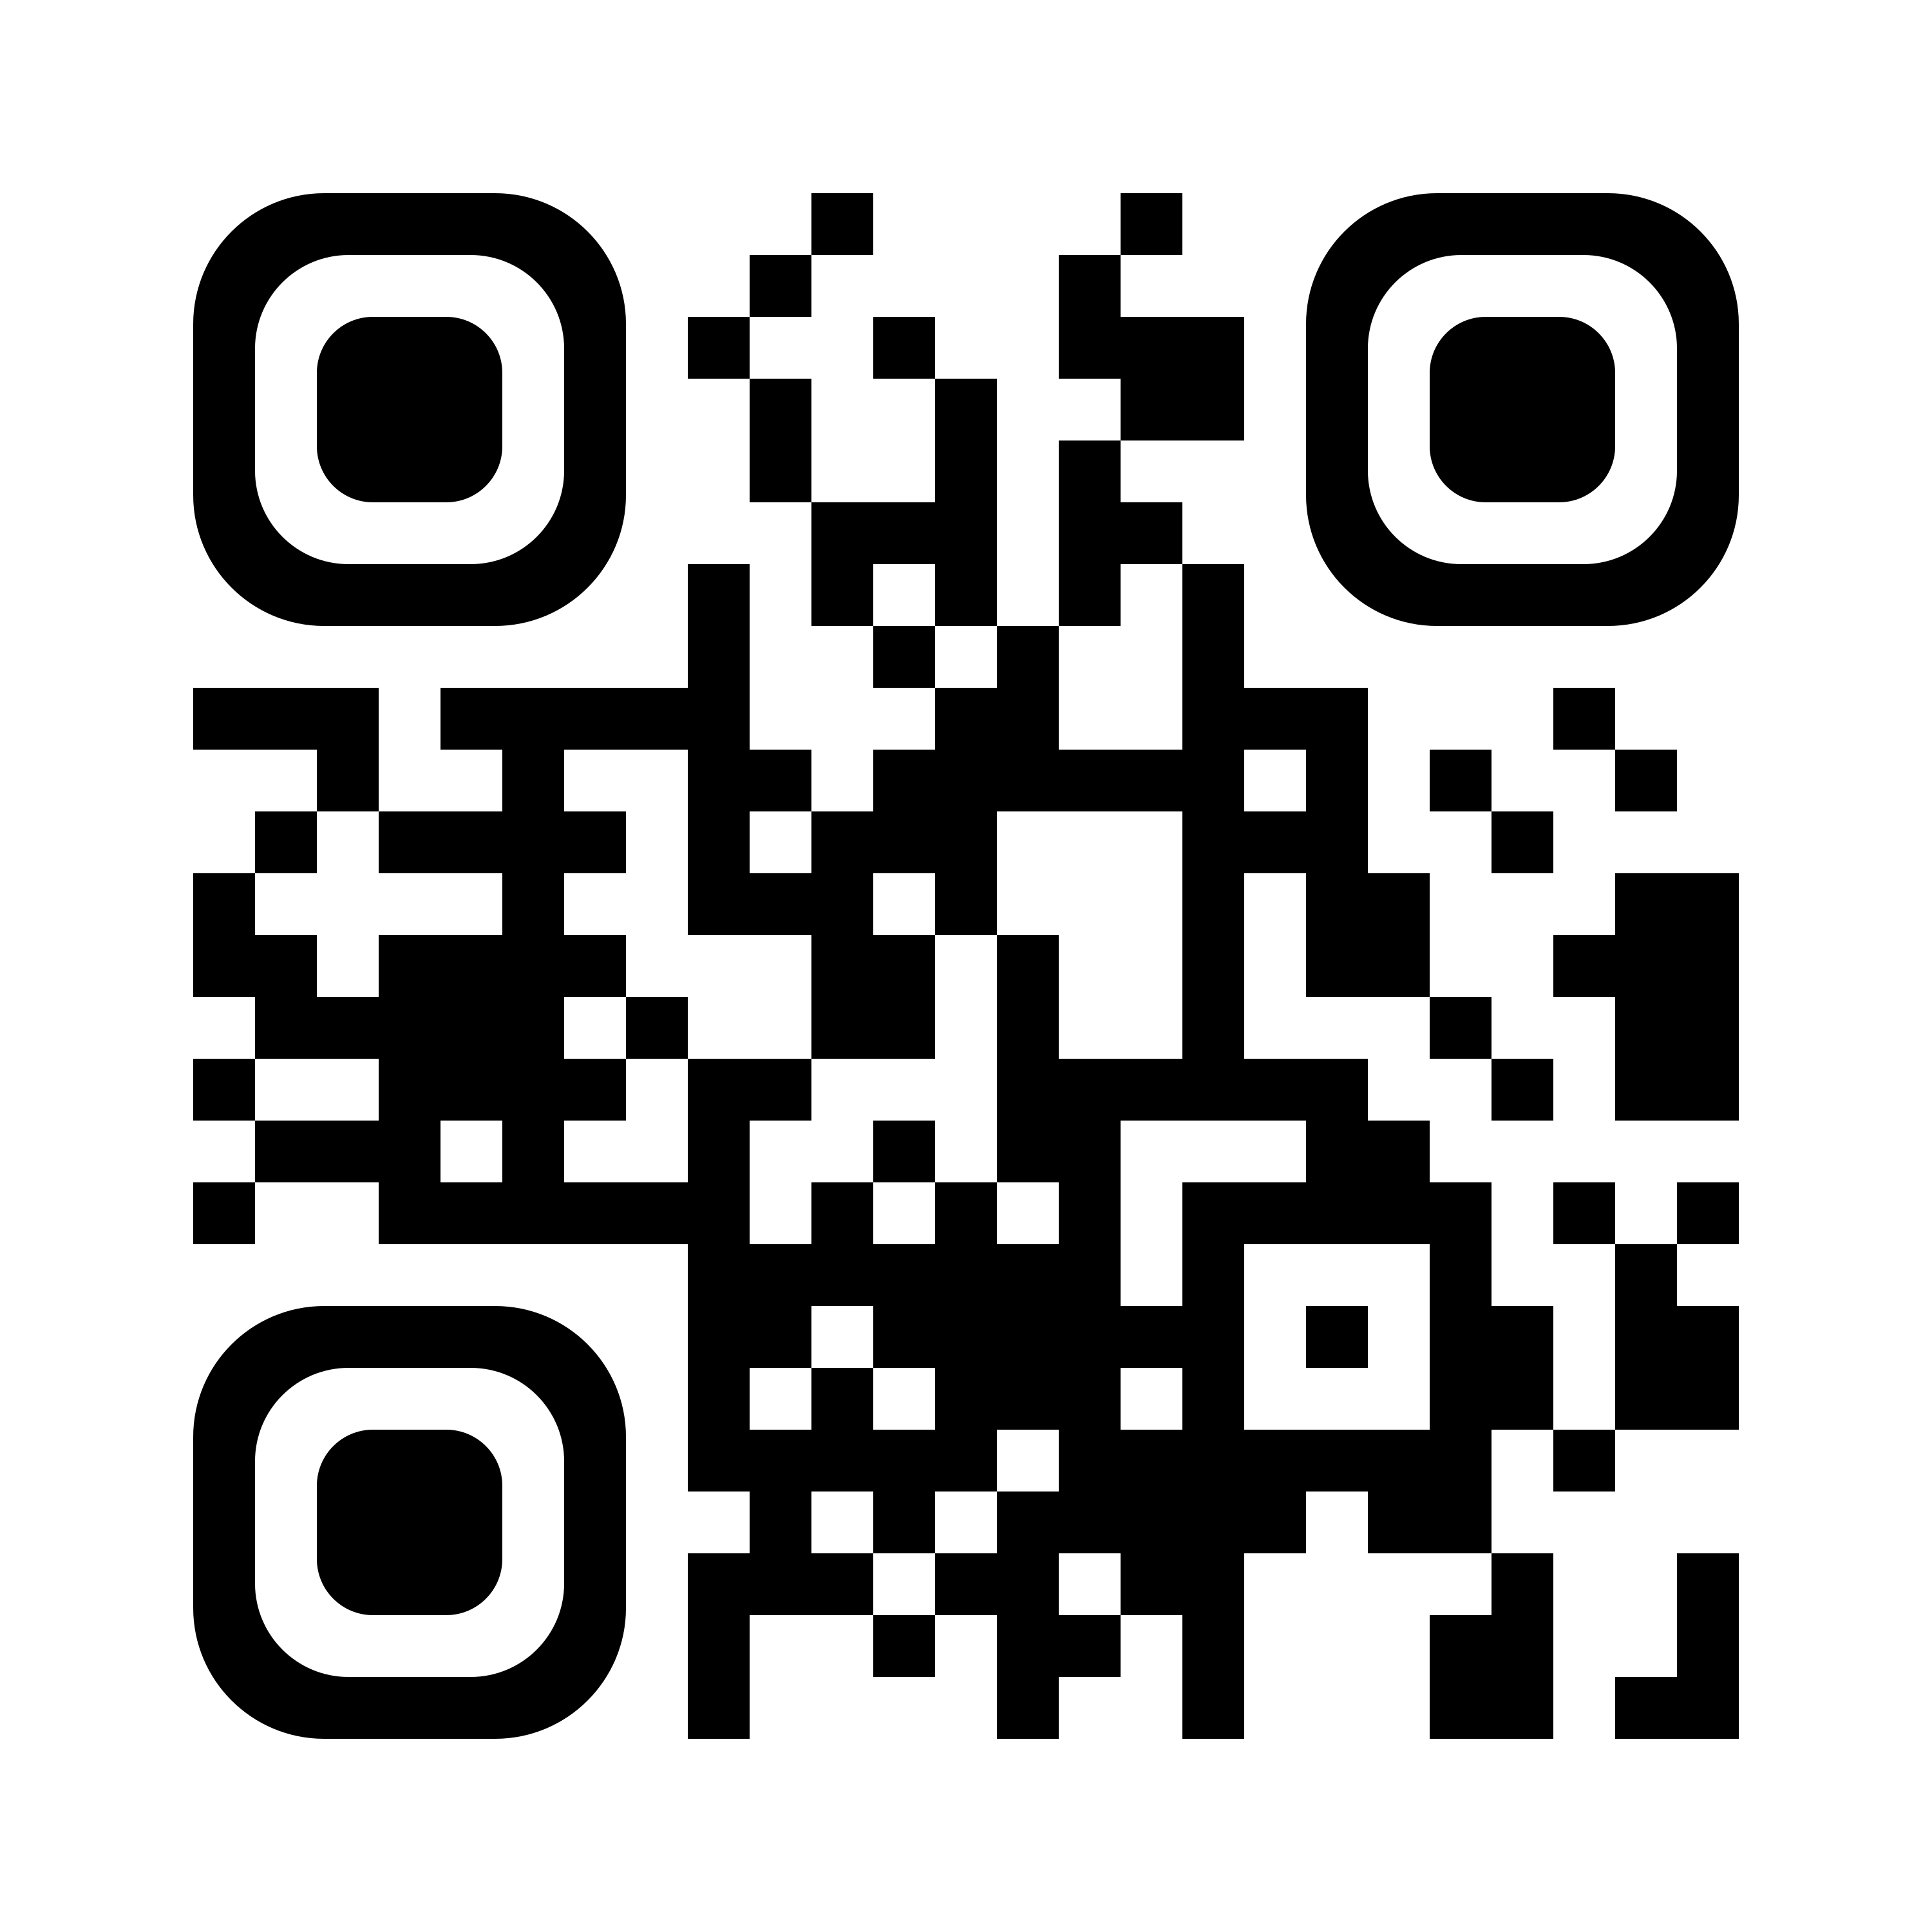
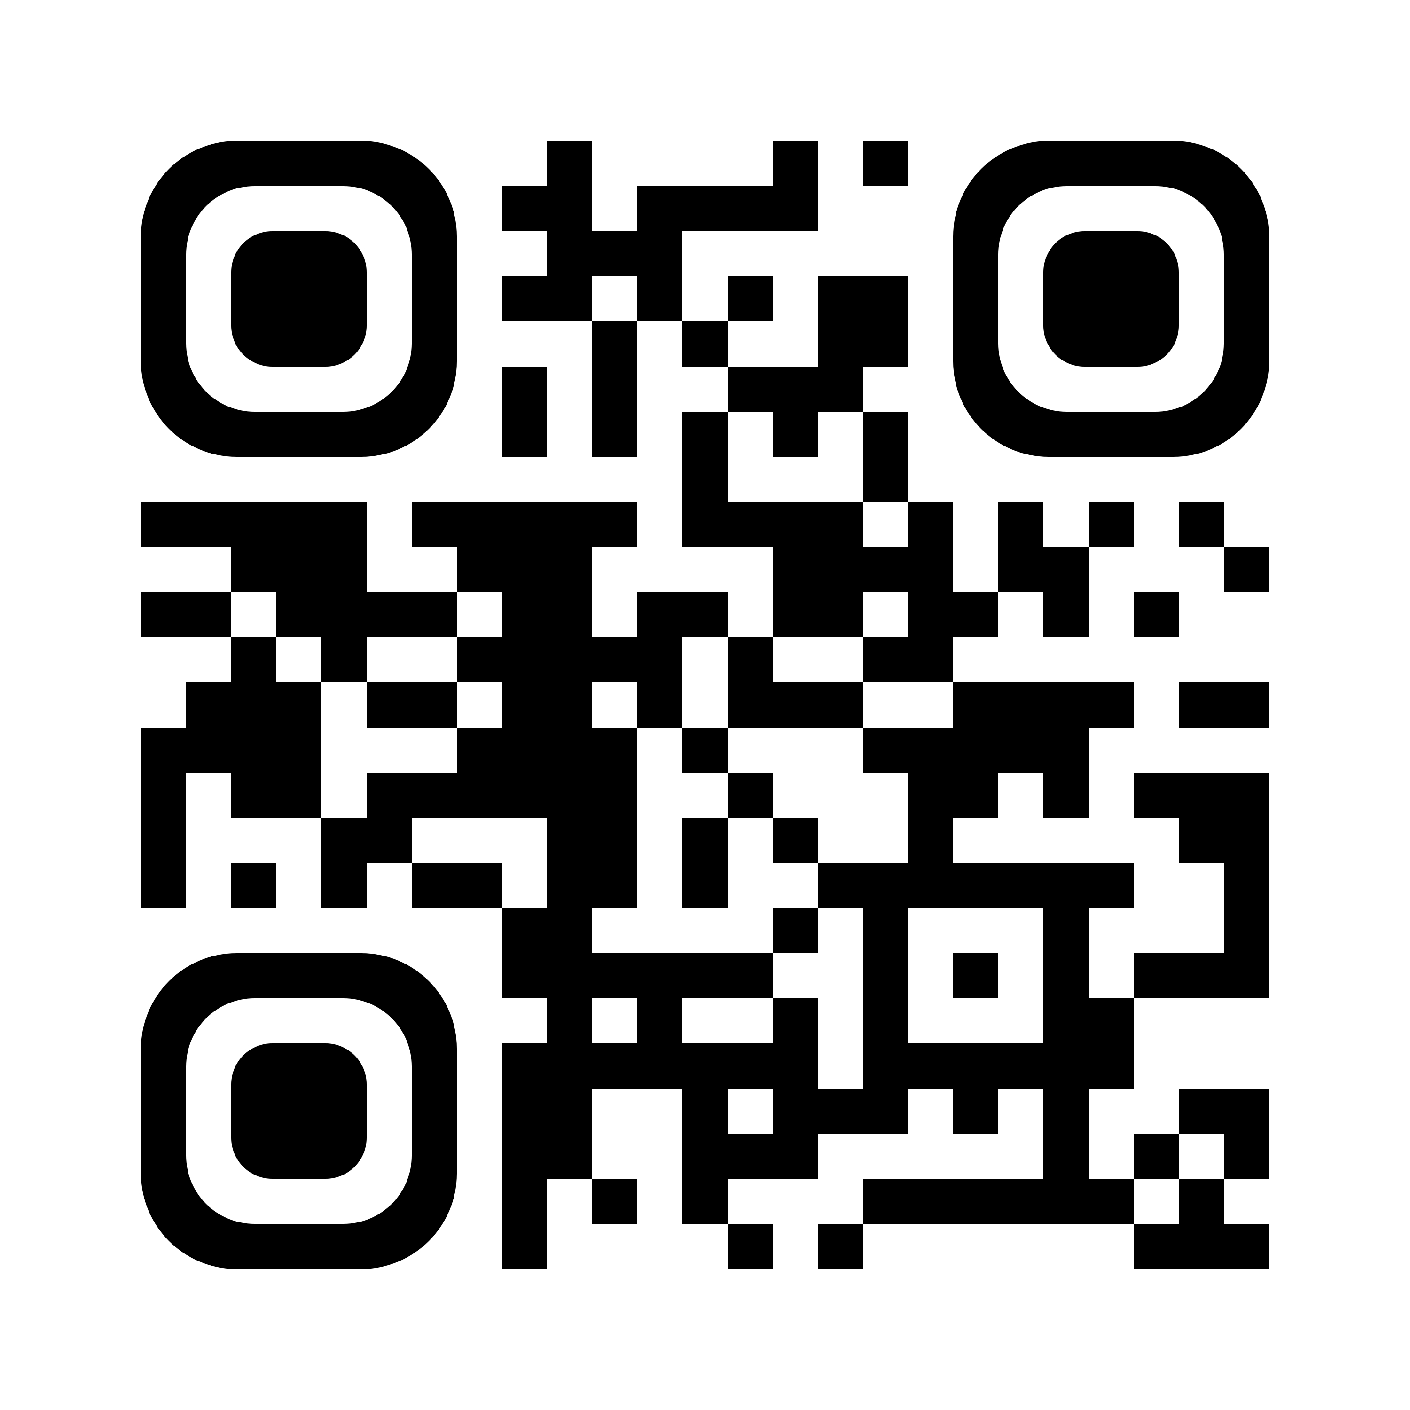


-AVS Social Media Platforms-
AVS72
Bluesky
X
@American Vacuum Society AVS
@avs-members
@AmericanVacuumSociety
@AVS_Members
@avs_events
Linked in
Facebook
Instagram

Slide 8
- Promote AVS 72 by E-mail, Print, or Other Media -
#1: Each Program Committee Member is requested to add 10+ contacts (watch for duplicates) to your topics
Google Contact Sheet and then reach out to solicit abstract submissions/promote the technical program, registration, etc.
Send Customized E-mails:
  Create your customized banner(s) using slides 9-11 highlighting speakers, deadlines, abstract submission, technical program, registration, awards, travel grants, exhibits, sponsors, etc. There is also an e-mail template to get you started.
Add a Slide to Your
Upcoming Presentations
  Add your custom banner to any presentation you are giving.
Add a Banner to Your
E-mail Signature:
  Link your custom banner to your topic page or www.avs72.avs.org.
Forward the AVS Call for
Abstracts E-mails:
  Forward the official AVS 72 Call for Abstracts e-mail (https://conta.cc/46Pq7Cz) (or any other AVS 72 e-mail you receive) to your colleagues (Note: Before forwarding, delete the Unsubscribe/ Update Profile options from the bottom of the e-mail).
Distribute Flyers:
  Use the AVS Flyer to post at your office or e-mail or create your own using the templates.
Refer to the AVS 72 Promotional Tips and Tools page for more ideas as well as additional graphics and updates.

Slide 9


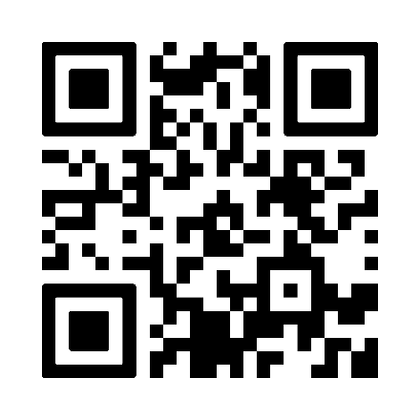
Enter Topic Name Here and Action:
2D Materials Call for Late News Abstracts Due: Sept. 14
Enter Statement of Your Choosing Here. See Tips on Slide 4.
Enter Name
Enter Affiliation
Enter Action Here

Slide 10

Enter Topic Name Here and Action:
2D Materials Call for Late News Abstracts: Due Sept. 14
Enter Statement of Your Choosing Here. See Tips on Slide 4.
Example: Don’t Miss These Invited Speakers
Enter Action Here
Enter Name
Enter Name
Enter Name
Enter Affiliation
Enter Affiliation
Enter Affiliation

Slide 11

Enter Topic Name Here and Action:
2D Materials Call for Late News Abstracts: Due Sept. 14
Enter Statement of Your Choosing Here. See Tips on Slide 4.
Example: Don’t Miss These Invited Speakers
Enter Action Here
Enter Name
Enter Name
Enter Name
Enter Affiliation
Enter Affiliation
Enter Affiliation

Slide 12

avs71.avs.org

Slide 13


Slide 14
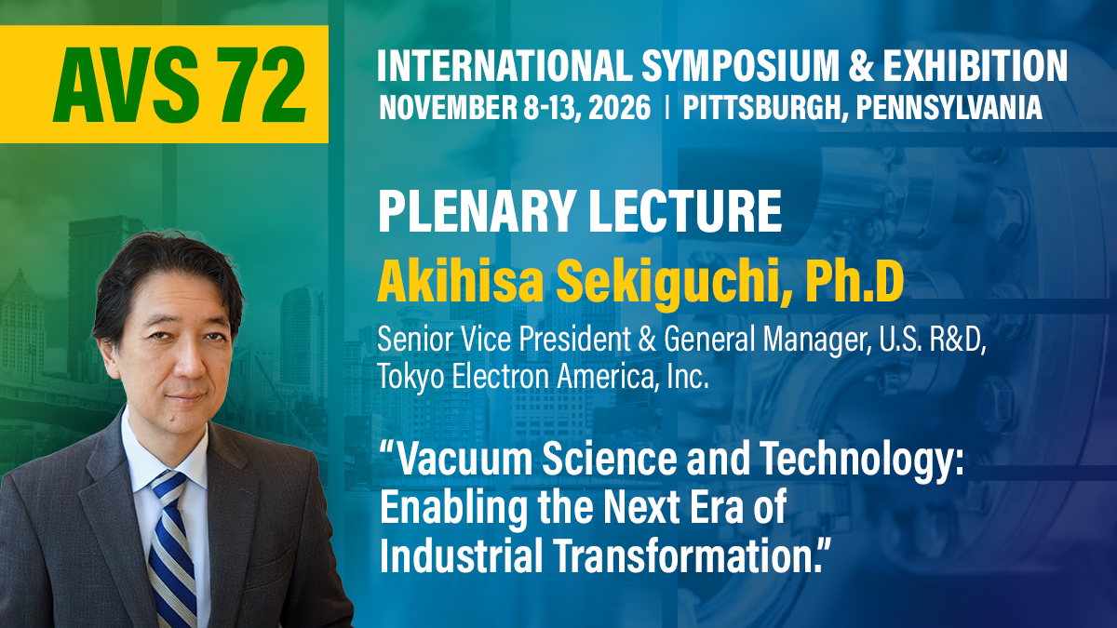

Slide 15




- Additional Banners & Links -
Note: These download to your download folder
AVS 72 Promotional Tips and Tools Website
AVS 72 Custom Banner PowerPoint Template
AVS 72 Banner Ad 300 x 250 (jpg)
AVS 72 Banner Ad Late News Call 350 x 350 (jpg)
AVS 72 Banner Ad 400 x 400 (jpg)
AVS 72 Banner Ad 600 x 90 (png)
AVS 72 Banner Ad Late News Call 1200 x 675 (jpg)
AVS 72 Banner Ad 1200 x 675 (jpg)
AVS 72 Banner Ad Call 1200 x 675 (jpg)
AVS 72 PPT Banner Ad 1920 x 190 (jpg)
AVS 72 Print Banner (jpg)
AVS 72 Print Ad (PDF)
AVS General Promo Slides

Slide 16



